Slide 1


Slide 2

#plugintonirvana
Group 5

Slide 3
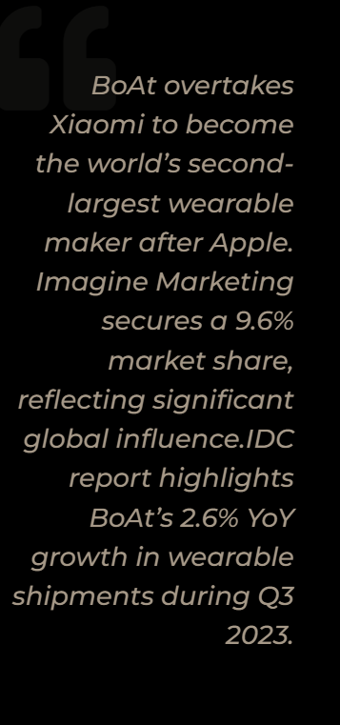

Slide 4
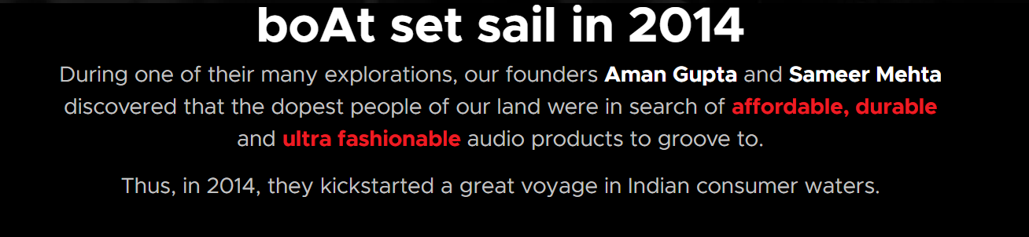

Slide 5


Slide 6


Slide 7
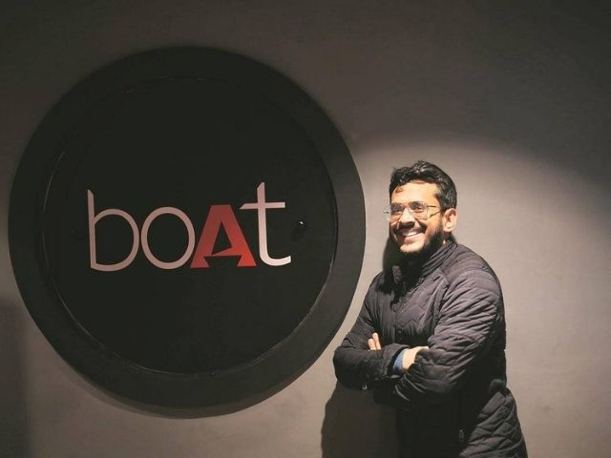

Slide 8

Product

Slide 9
Meeting marketing needs
Exceptional audio-optimal sound quality
Innovative design
“You’ve plugged into Nirvana”
Product Innovation
Product Range
Diverse Portfolio
Manufacturing & Supply Chain
Most revenue from audio category
Rocekrz 450 headphones, Airdopes 141
Penetrating smartwatch market
Features

Slide 10
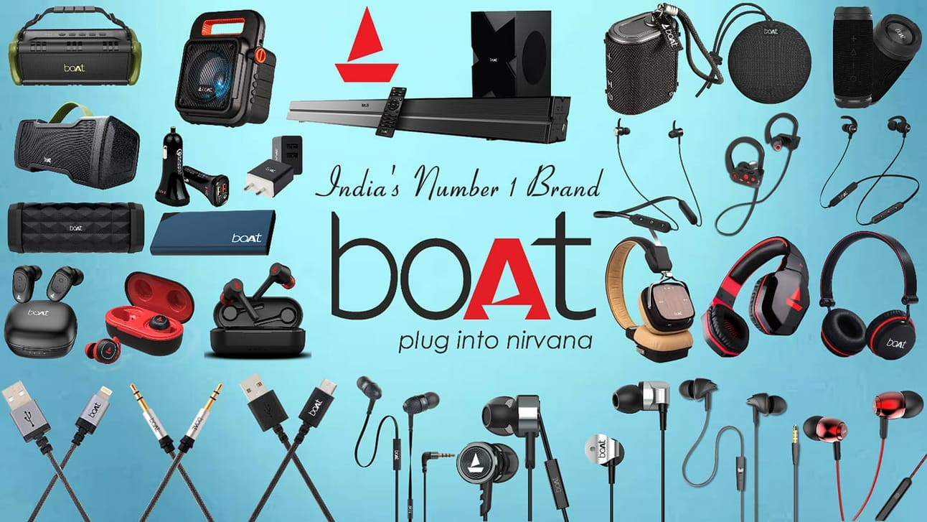

Slide 11
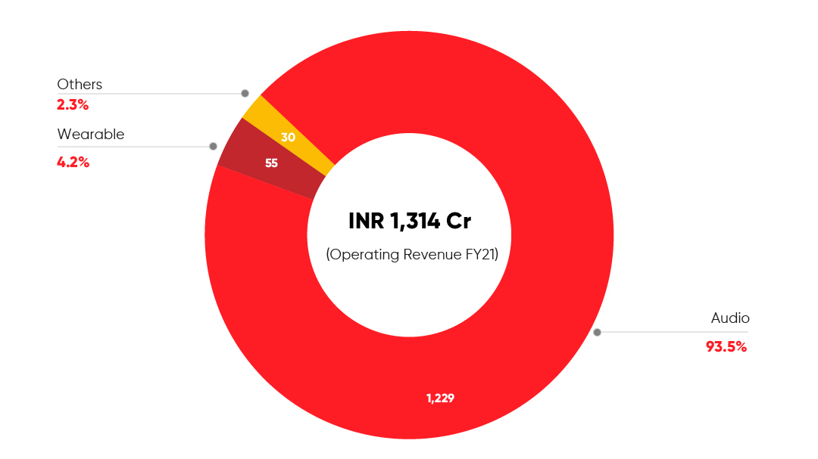

Slide 12
Price

Slide 13
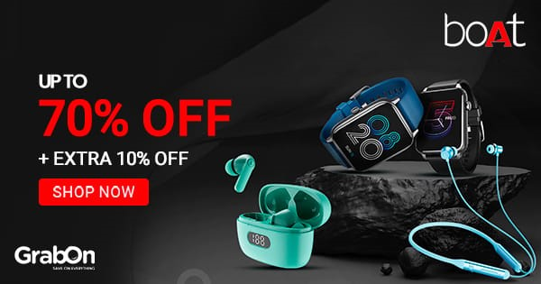
Affordable Pricing Strategy
Balance -Affordability & Performance
Product range Rs 1,000-5,000
Target - Young consumers
Customer trust & increasing market share

Slide 14
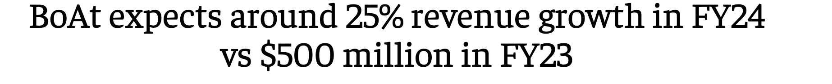
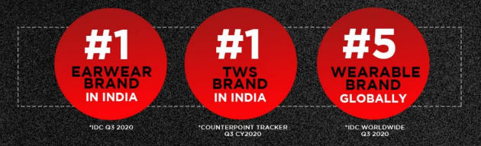
Revenue Trends
FY2023, operating revenue was worth about 40 billion Indian rupees
Profitable for 8 consecutive yrs faced a loss of Rs. 129.4 cr in FY2023

Slide 15
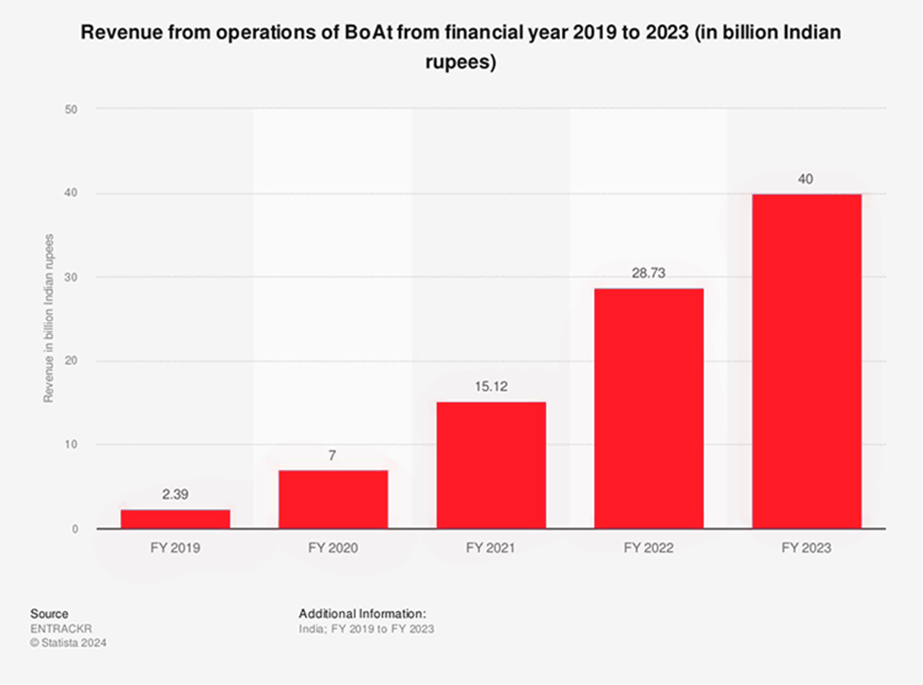

Slide 16
Pricing Strategies

Slide 17
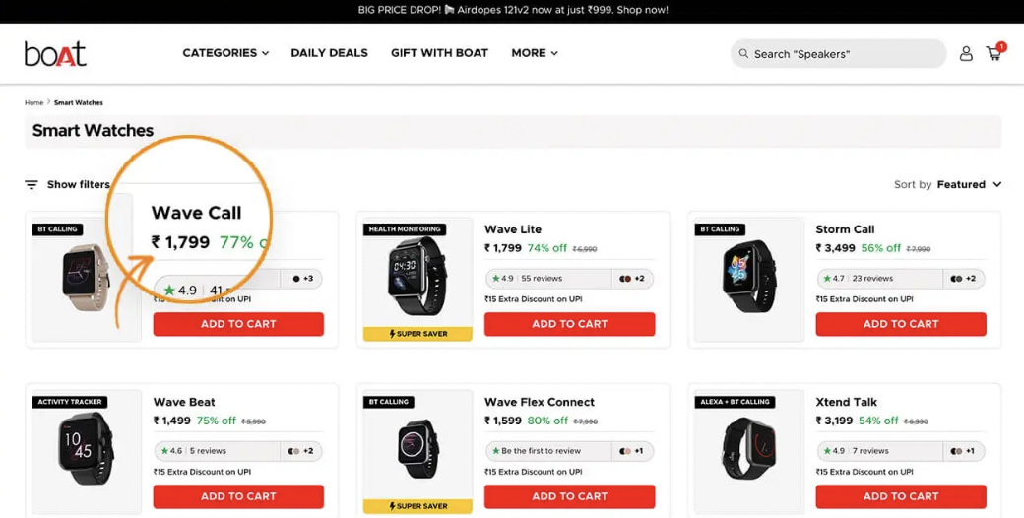
Charm Pricing

Slide 18
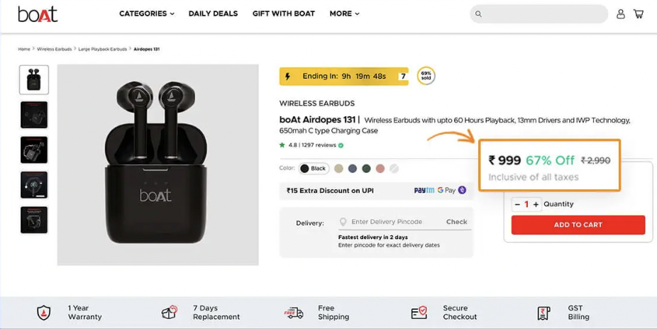
Compare At Price

Slide 19
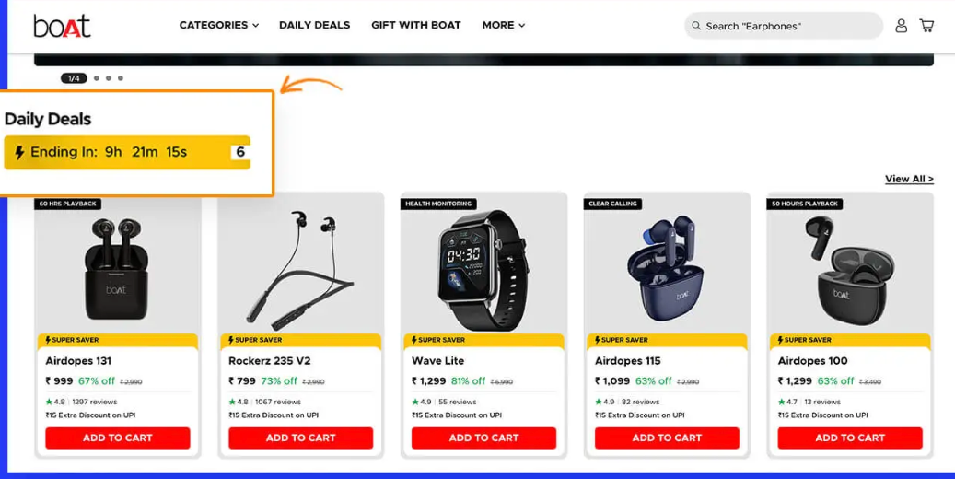
Daily Deals Catalogue

Slide 20
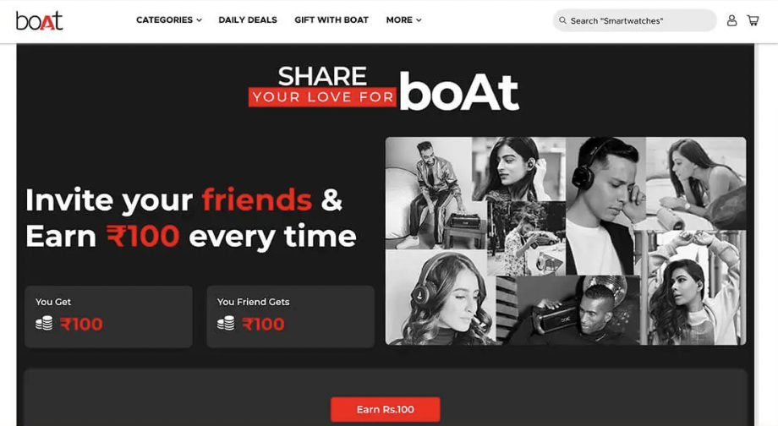
Referrals

Slide 21
Place

Slide 22
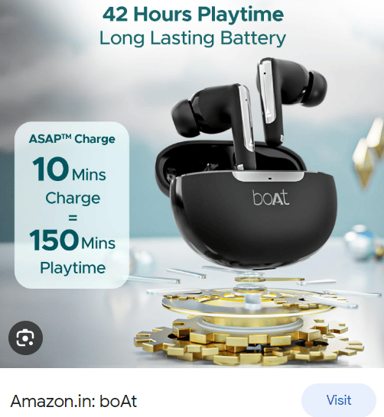
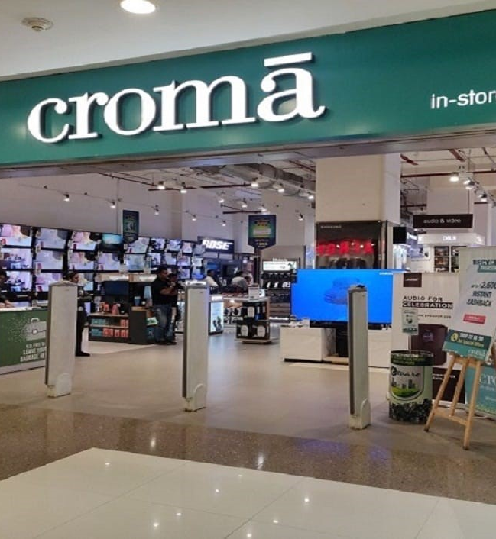

Slide 23
Direct To Consumer experience
Own website
Entire product portfolio
Exclusive deals, discounts
Relationship building

Slide 24
Omnichannel –maximizing the marketing
Started off with popular E-commerce stores
13K+ retail stores serving 20+ million customers so far
40+ modern retail/regional retail stores
Increased accessibility for in-store purchases
Delivery Strategy
Potential cost-effectiveness of distribution channels
Third party logistics - risks
Logistic/local infrastructure issues
Limiting online selling marketplaces to 2-3
Challenges & Innovation

Slide 25
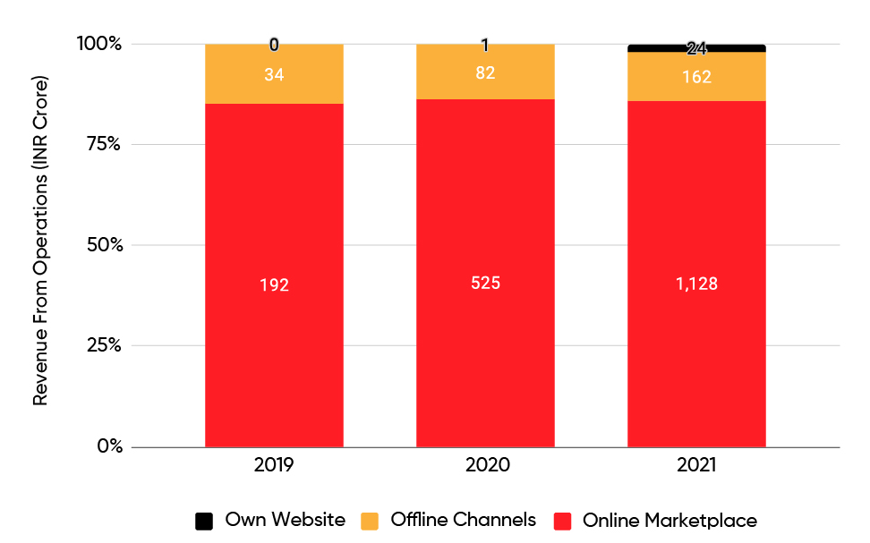
On average, 86% of its total sales came from online marketplaces from these 3 years

Slide 26
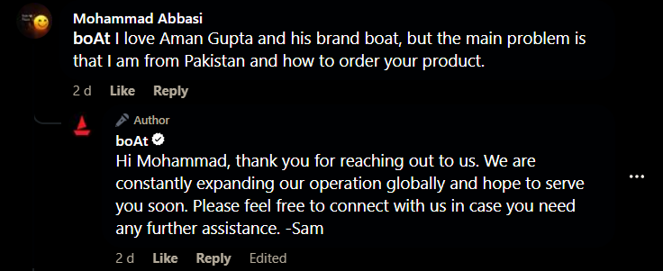

Slide 27
Promotion

Slide 28
Do What #FloatsYourboAt
It's You! It's someone who loves to groove, is always on the move, and crazy about reaching their goals!

Slide 29

boAt X Bollywood

Slide 30
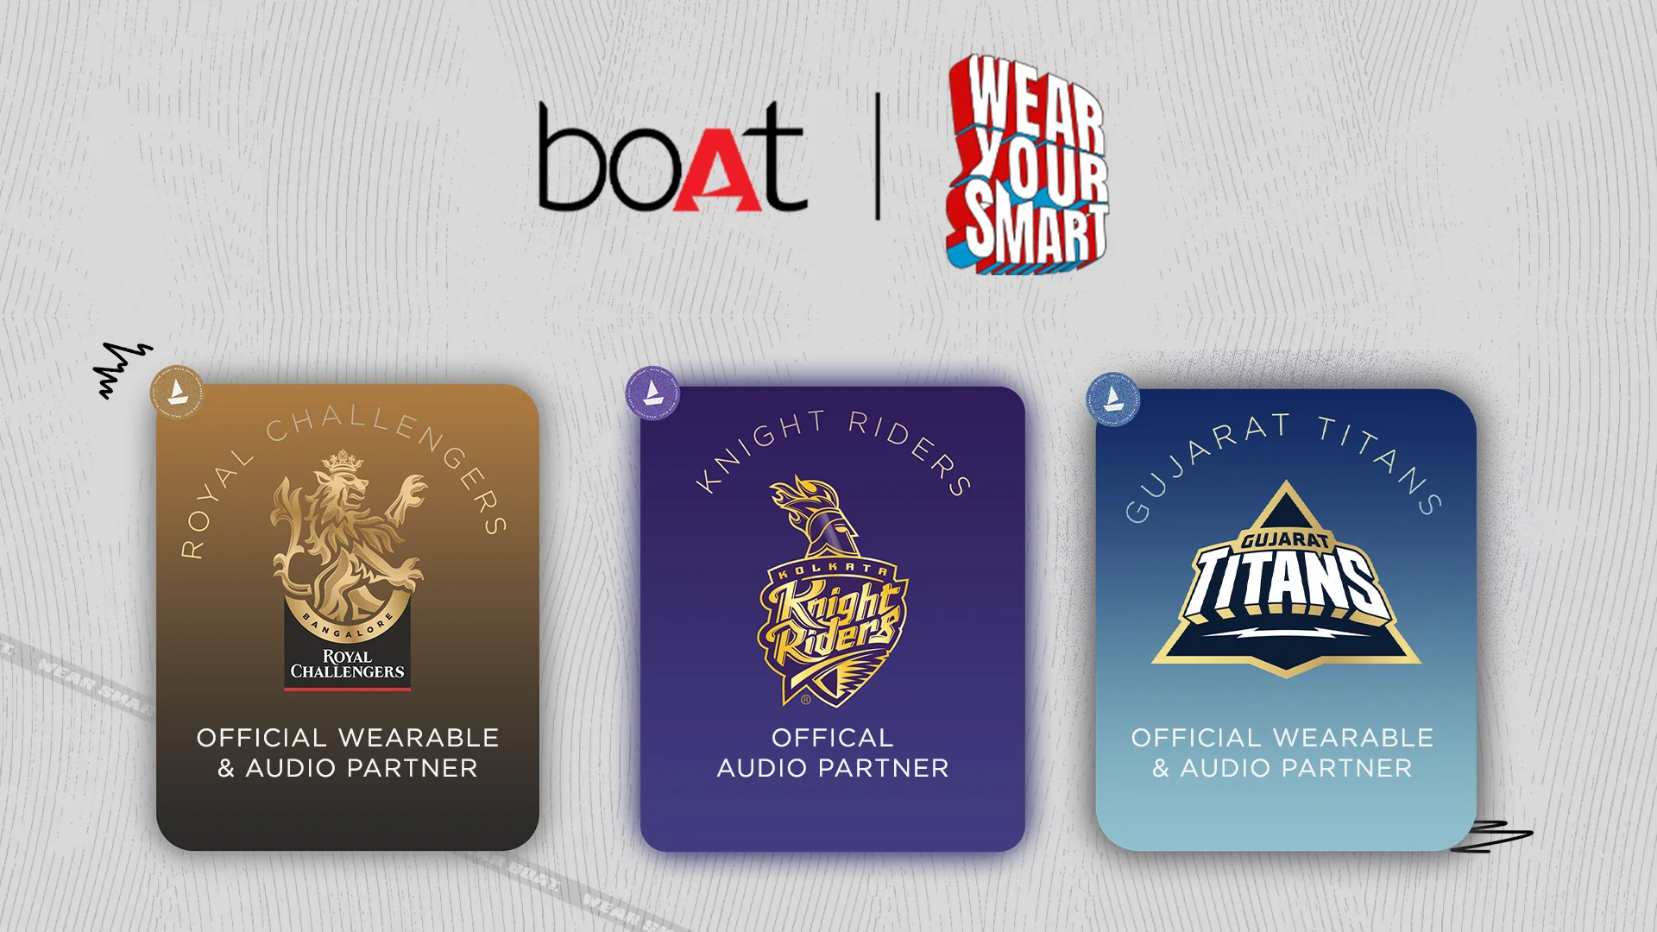

Slide 31
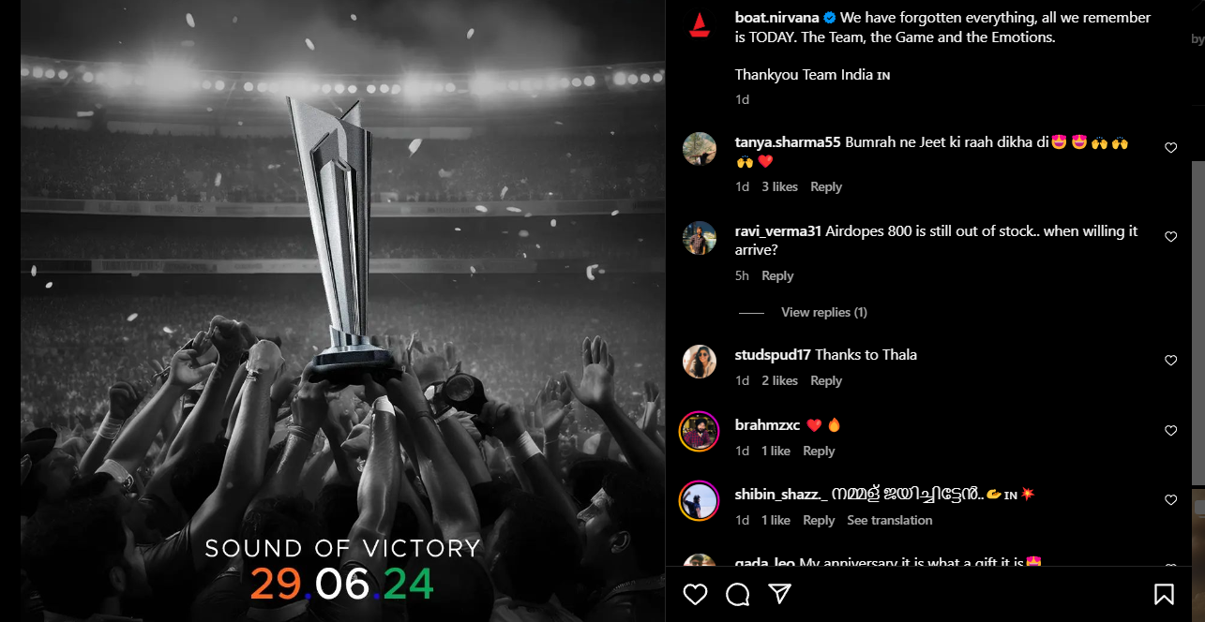

Slide 32
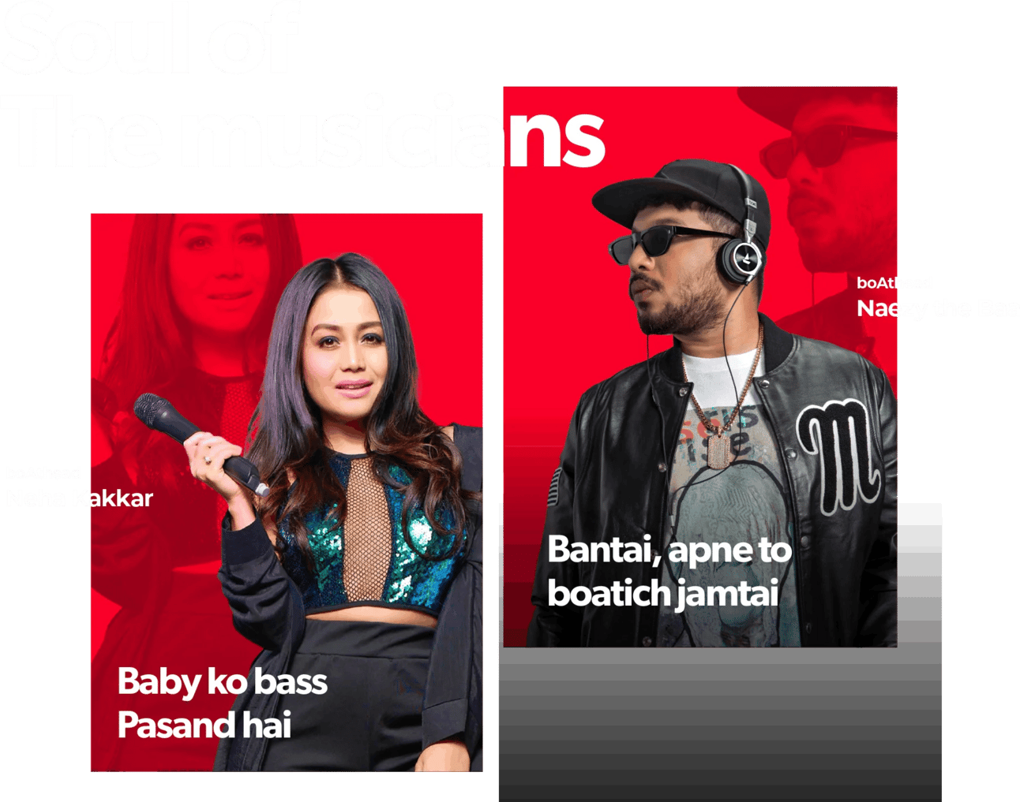
boAt X Musicians

Slide 33


Slide 34
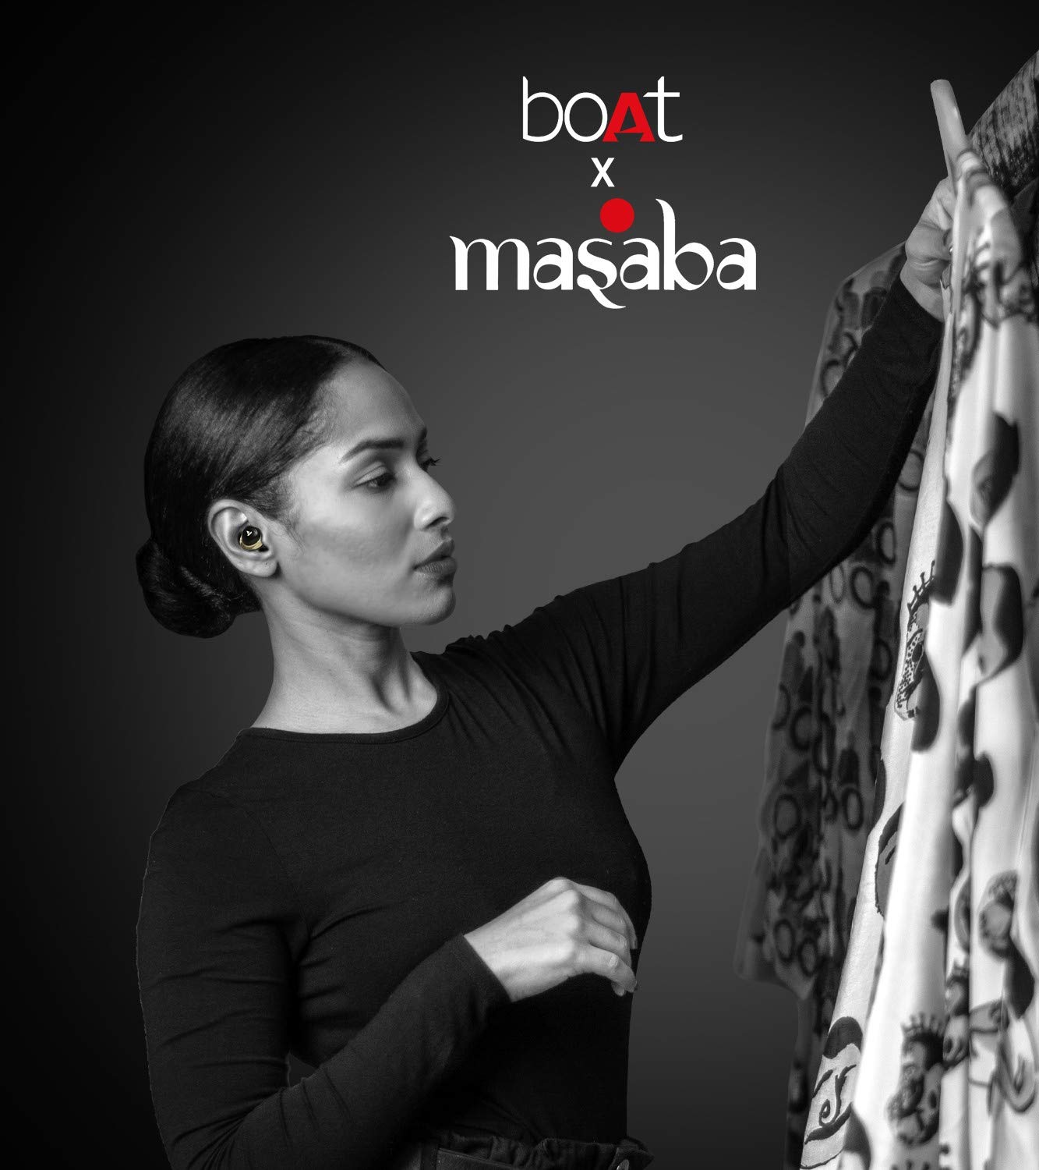
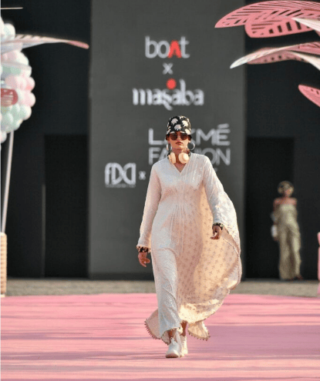

Slide 35
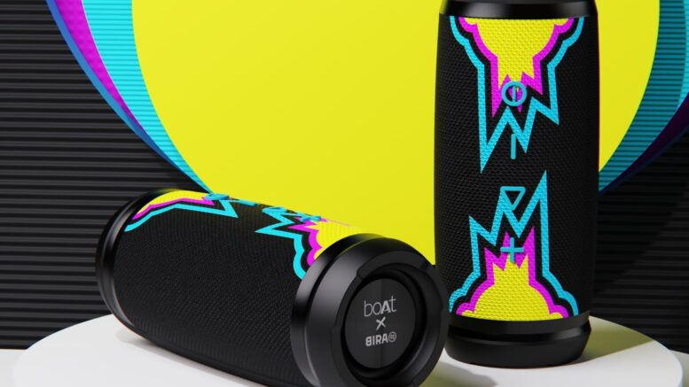
boAt X Bira 91

Slide 36
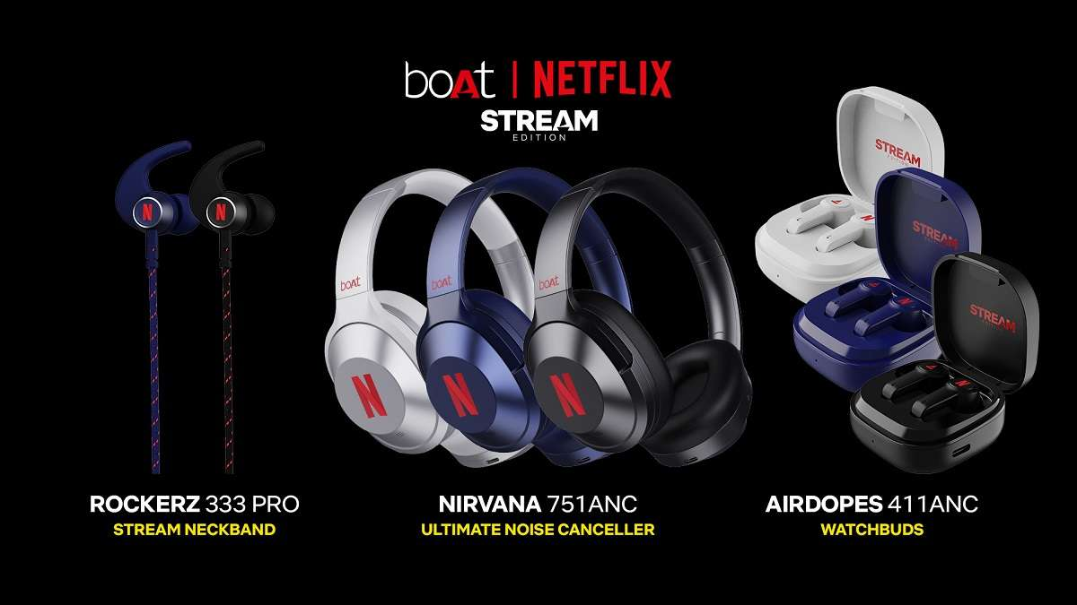

Slide 37
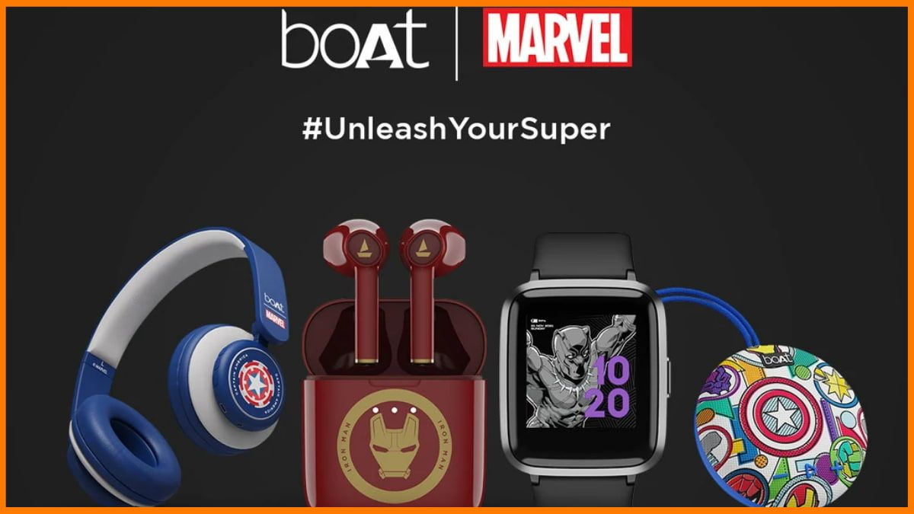

Slide 38
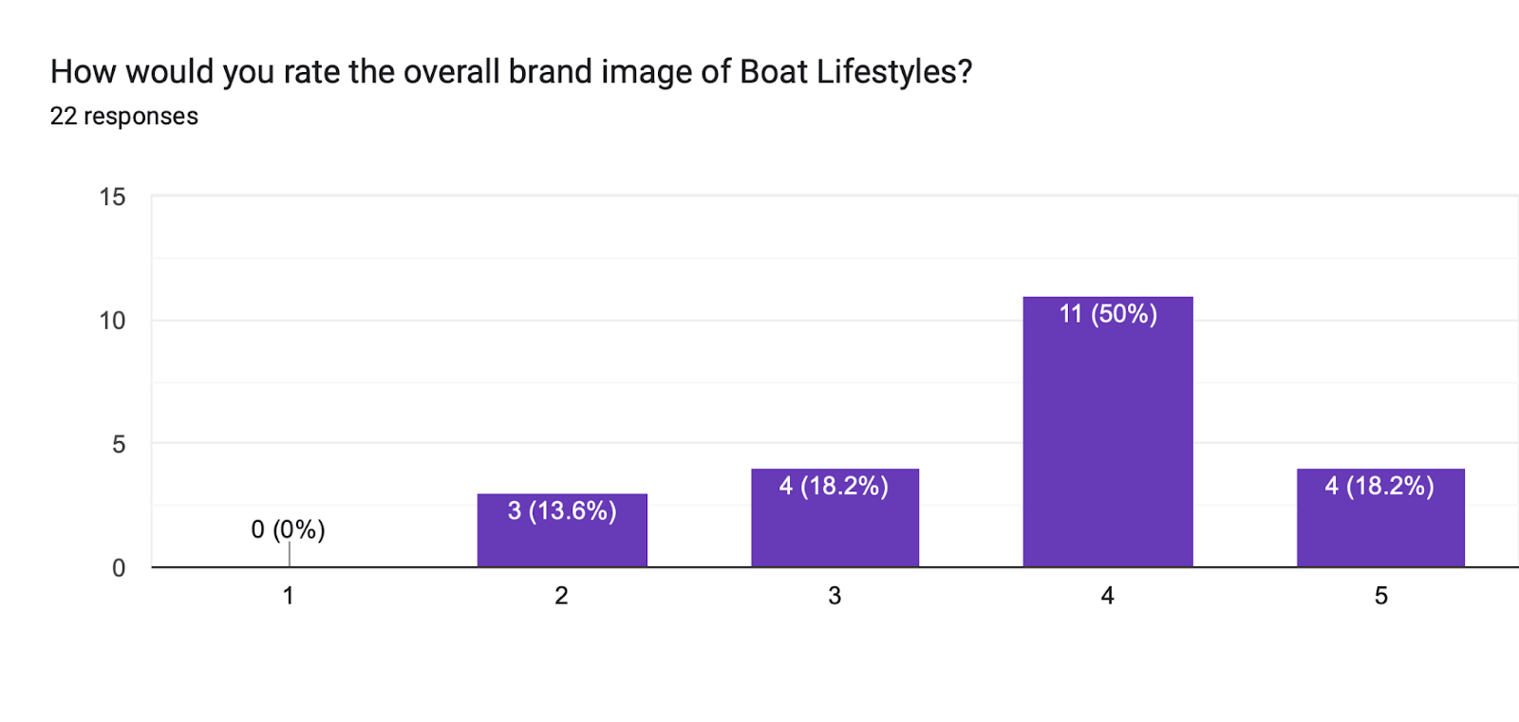
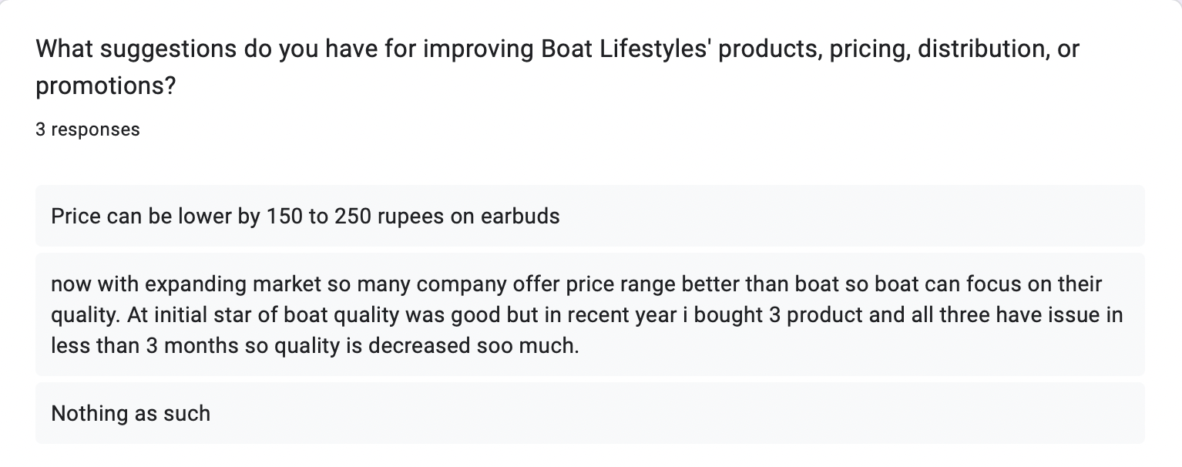
Survey Responses

Slide 39
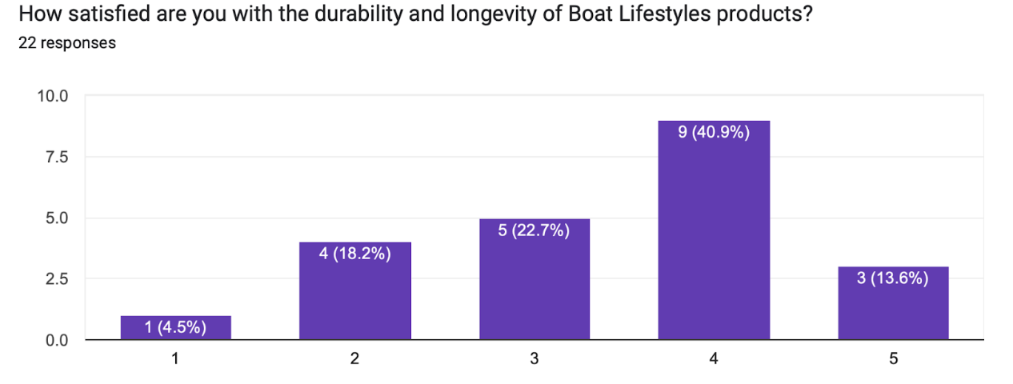
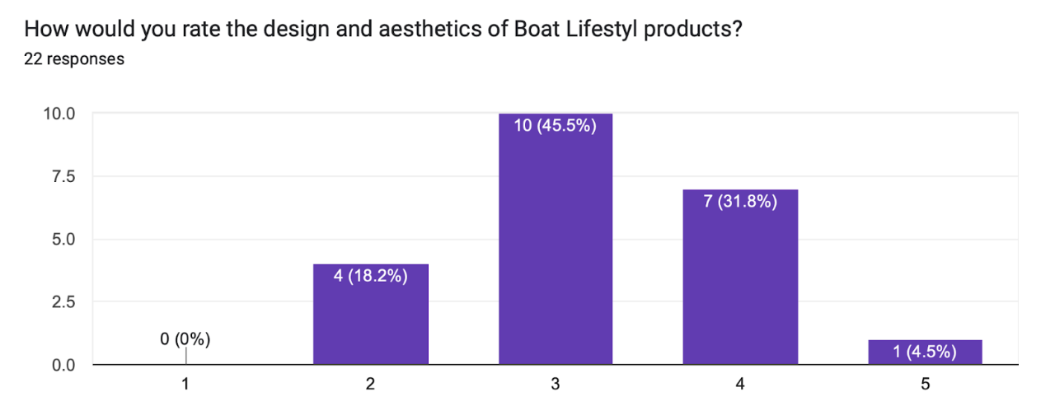
Product

Slide 40
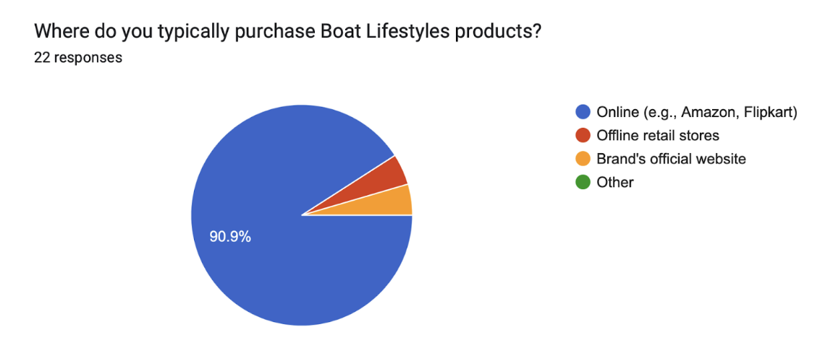
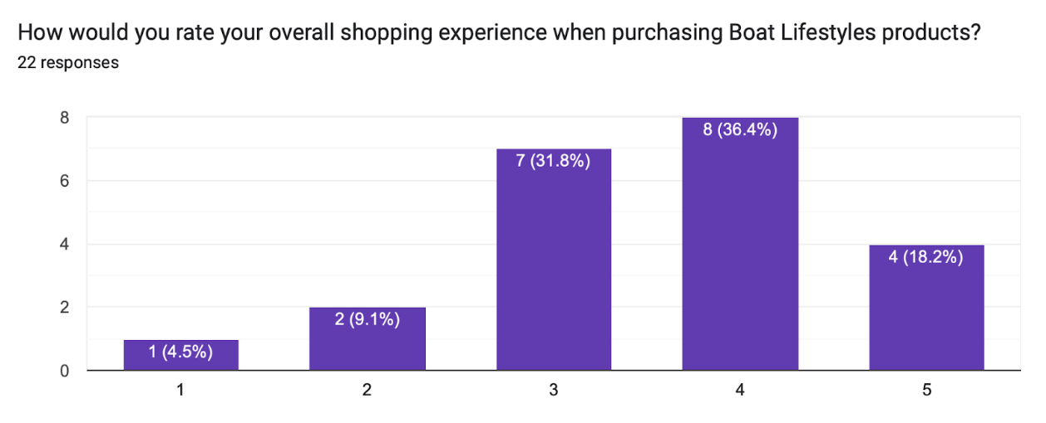
Place

Slide 41
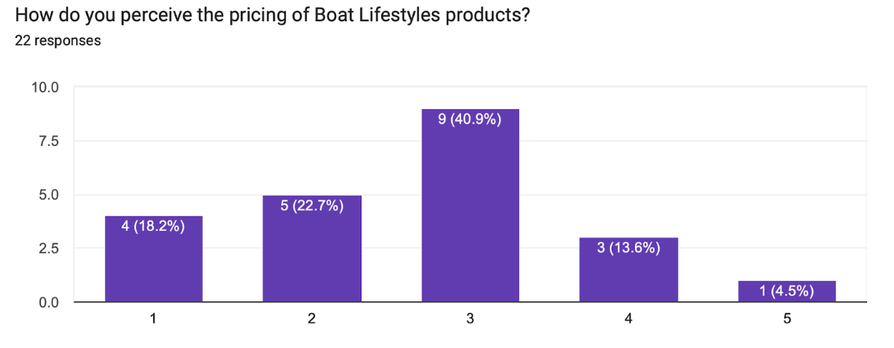
Price

Slide 42
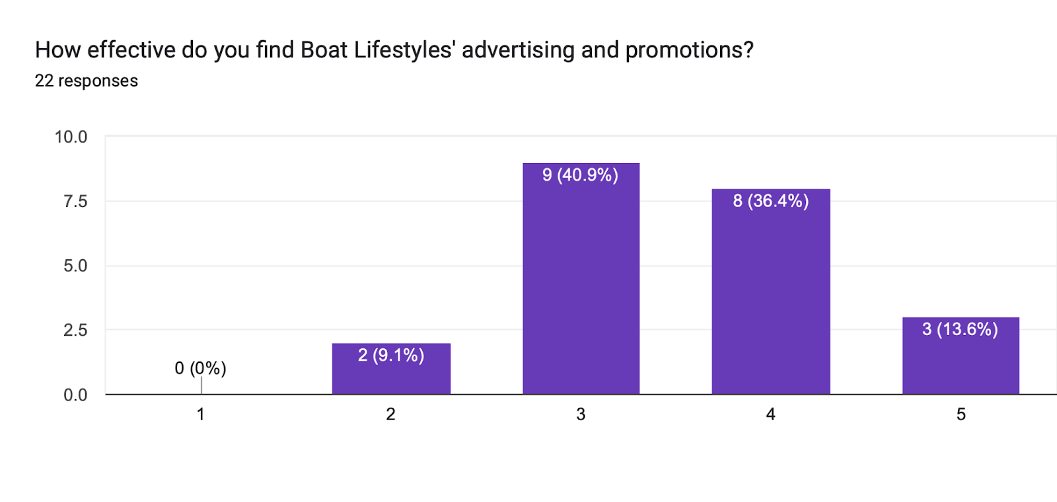
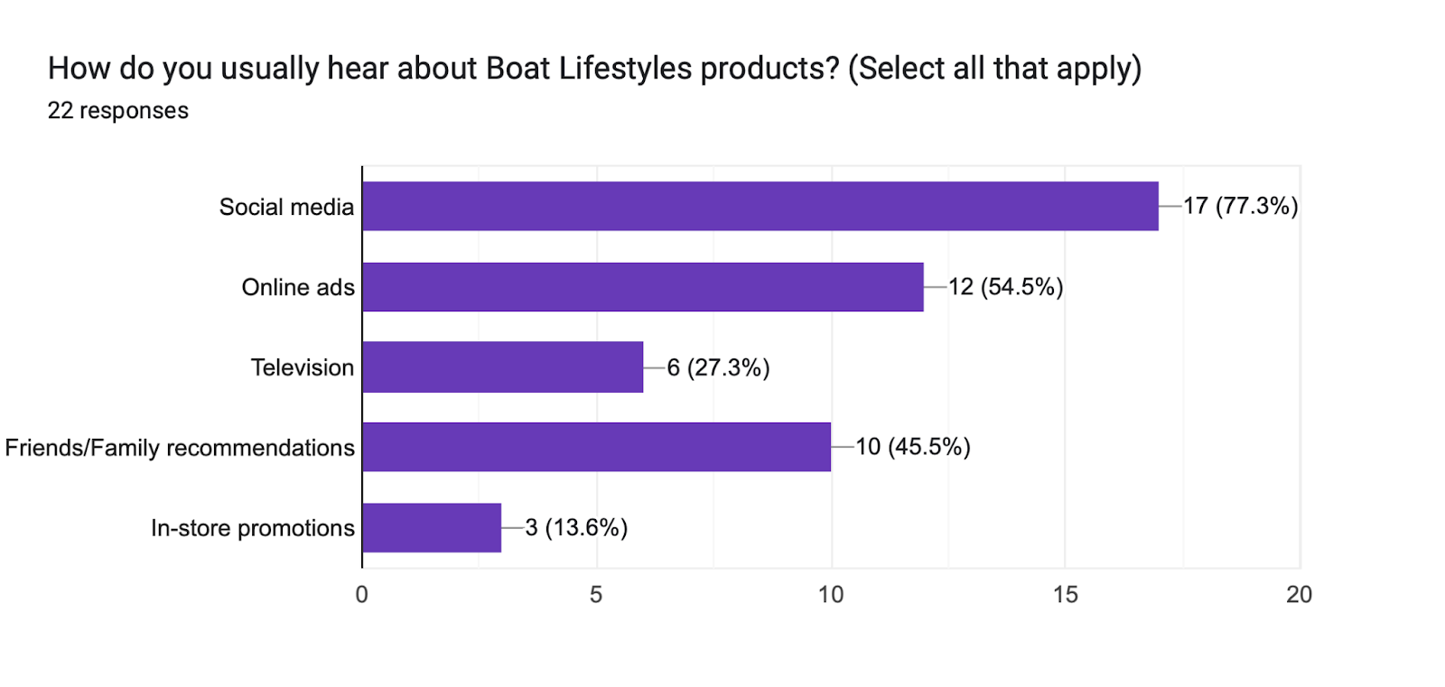
Promotion

Slide 43
Repositioning
Not truly based on survey –can be dishonest
Small number of responses
Got suggestions from personal brief interviews as well

Slide 44
Product
Place
Stylish covers
Personalization options
Strengthening bond with customers
Products reflecting personality/style
Recyclable premium materials
Voice-activated smart assistants
Product diversification
Experience and try centers
Expanding retail presence
Efficient delivery partners
Price
Promotion
Influencer collaborations
Cross-promotion
#myboAtCut –trimmer- #findyourownboAtCut
Collaborative health campaigns
Target health-conscious audience
Create value for money
Affordable-less price as quality compromised
Balance-quality & performance

Slide 45
References
https://www.ciim.in/boat-case-study-marketing-strategy/#:~:text=As%20of%20December%202020%2C%20boAt,relevant%20in%20the%20target%20industry.
https://konigle.com/blog/boat-case-study
https://startuptalky.com/boat-case-study/
https://www.statista.com/statistics/1322881/boat-financial-indicators/
https://www.financialexpress.com/life/technology-boat-sees-offline-sales-growth-trump-online-this-year-3431067/

Slide 46
Thank You

